Slide 1
Data Analysis of Companies
Data Cleaning & Preparation
Dashboard and Insights
Exploratory Data Analysis.
Insight Generation.
By Shubham Kumar
SVNIT, Surat

Slide 2
1. Data Cleaning & Preparation
Initial Quality Check (QC):
Conducted QC to identify any discrepancies or anomalies.
Primarily focused on identifying and handling null values.
Data Formatting:
Formatted data to ensure consistency and uniformity.
Special attention given to converting date-time fields for analysis.
Steps Followed:
Coverted date joined column to DateTime format and extracted year from the same.
The data set contains a total of 17 Null values, out of them 16 Nan values are from the city column and 1 from the select_investor column. I kept as null values as it is without imputing with any other value.
There are No Duplicate Rows Present in the Data set.
Created separate columns for funding and valuation by extracting numbers out of them only. Also, there are 12 Unknown Values in the Funding column
Created a Separate column Years_taken_to_unicorn by subtracting year founded from year Joined column (assumption if any company crosses 1 Billion in valuation it becomes a unicorn)

Slide 3
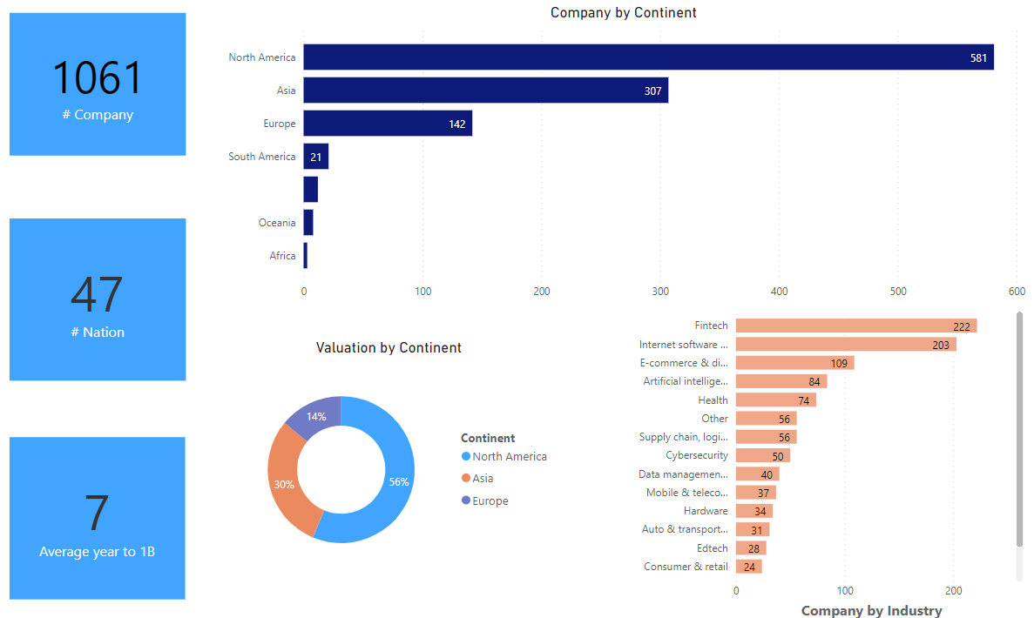
Dashboard 1

Slide 4
Dashboard 1 insights
There are 1061 unique Companies belonging to 47 different Nations.
The average year to cross a mark of 1 billion valuation is 7.
North America accounts for more than 50% of unicorns followed by Asia and Europe
North America comprises the valuation of companies approximately 56%, and the rest major portion held by Asia & Europe.
Most unicorn companies belong to Fintech, E-commerce & direct to customers, software, and Artificial Intelligence.

Slide 5
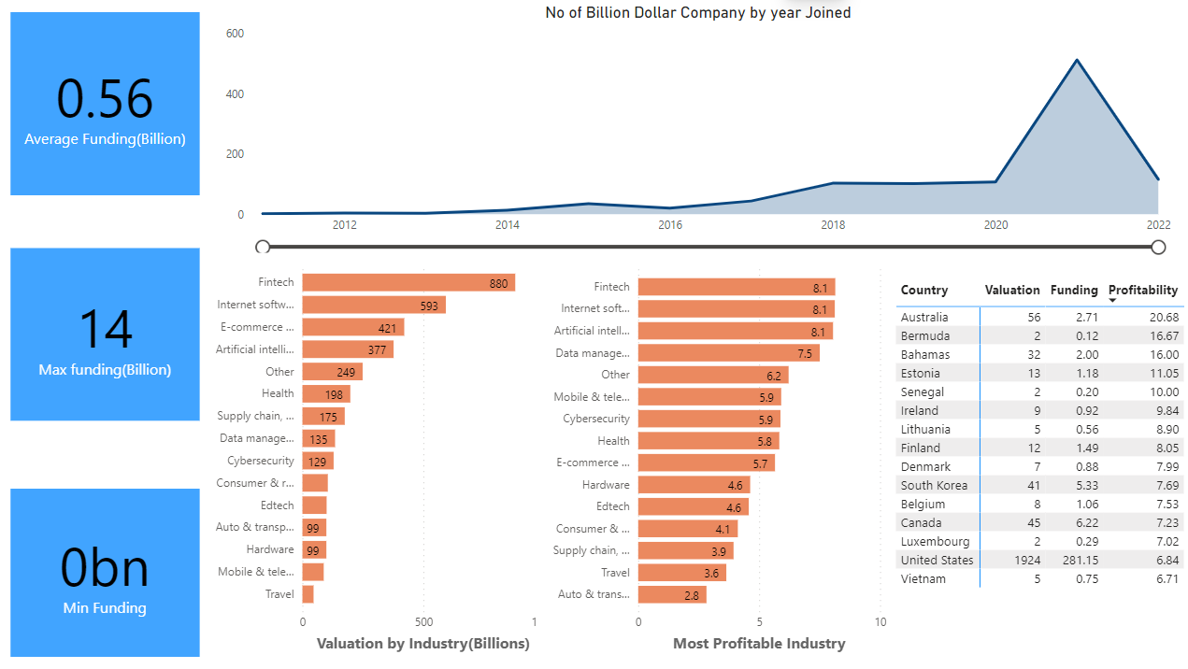
Dashboard 2

Slide 6
Dashboard 2 Insights
The Average Funding of the companies is around 0.56 billion and the max funding is around 14 billion & min is 0.
The number of billion-dollar companies has been increasing over the years, there is a sharp increase from 2020 to 2021 and here I am assuming due to the ease in COVID restrictions of the first wave.
The number of billion-dollar companies starts decreasing from 2021 to 2022 and here I am assuming due to the covid second wave.
The most valuable unicorn industries are Fintech, E-commerce, Software, and Artificial Intelligence.
The most profitable unicorn industries are Fintech, Software, and Artificial Intelligence, which have the highest valuation-to-funding ratio.
Australia, Bermuda & Bahamas are among the most profitable countries.

Slide 7
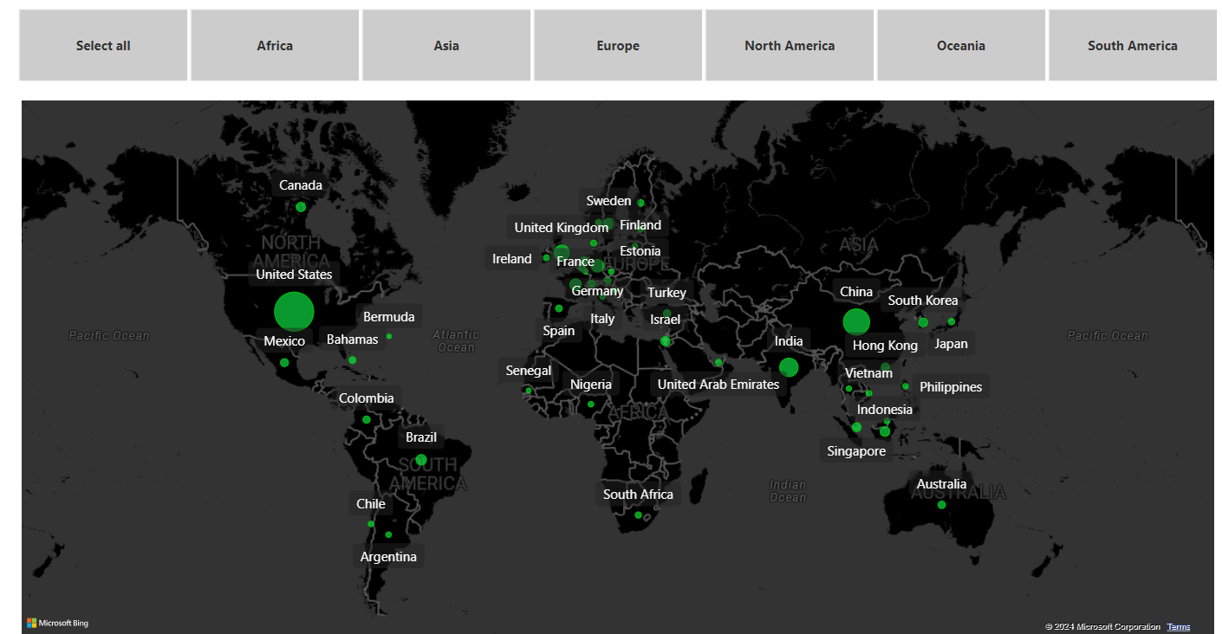
Dashboard 3

Slide 8
Dashboard 3 Insights
USA, India, and China are the highly funded countries.
It is clearly visible from dashboard 2 and dashboard 3 that there is a strong correlation between funding and no of unicorns.
Oceania & South America has a very low no of companies that are getting funded.

Slide 9
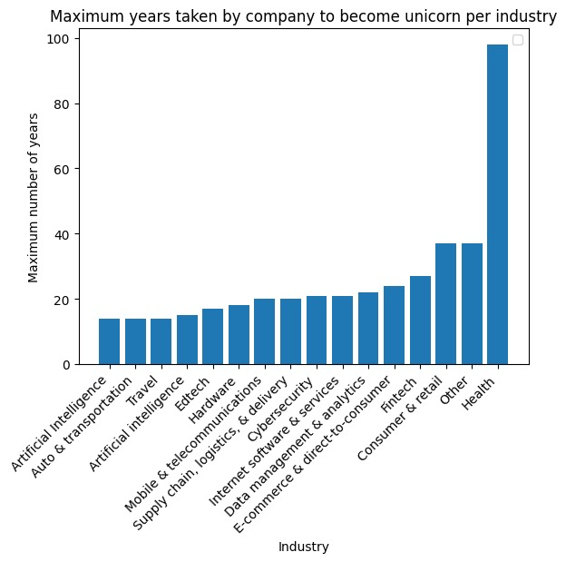
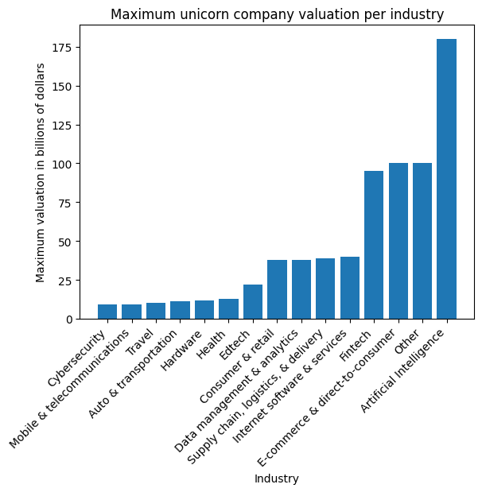
Exploratory Data Analysis.
As we can see from the left graph, the health industry takes a maximum of years to become a unicorn. Artificial Intelligence and Auto & transportation take very little time to cross 1 billion.
The right graph shows that the Artificial Intelligence industry has the highest no of unicorn companies followed by Fintech and E-commerce.

Slide 10
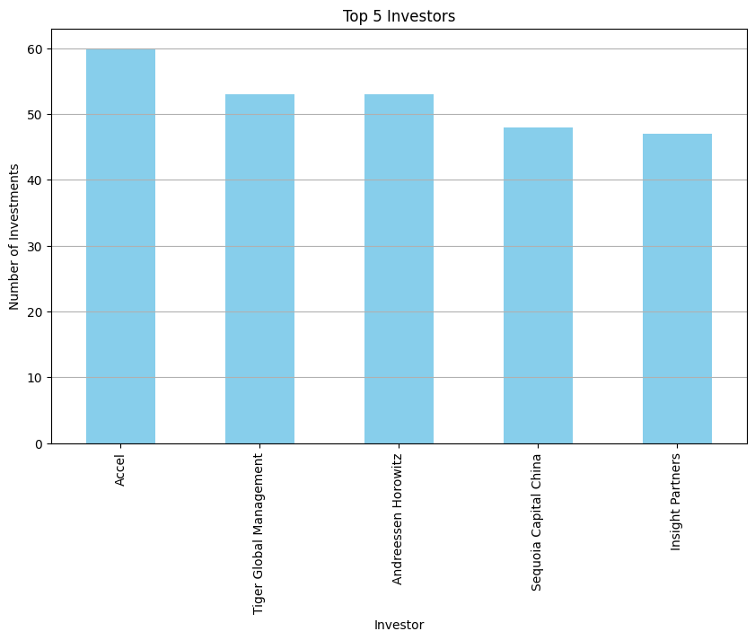
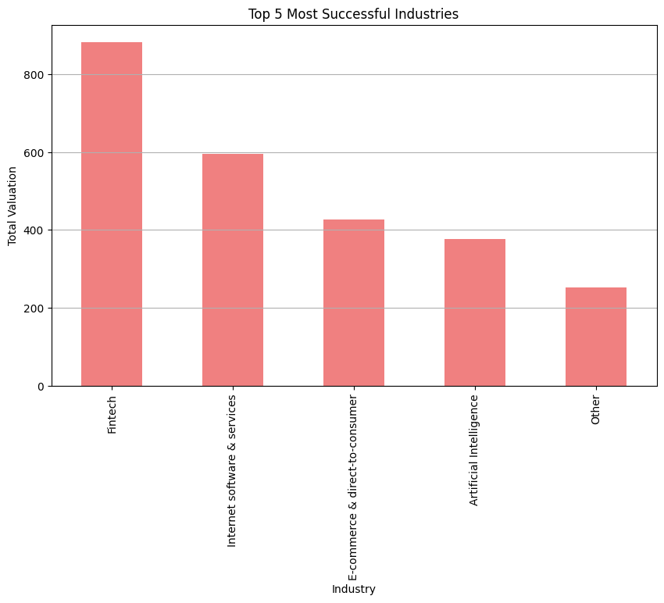
Accel is the top investor in 60 companies, followed by Tiger Global Management, and Andreessen Horowitz
As we can see from the right graph Fintech is the top-most successful Industry having a valuation of over 800 billion.

Slide 11
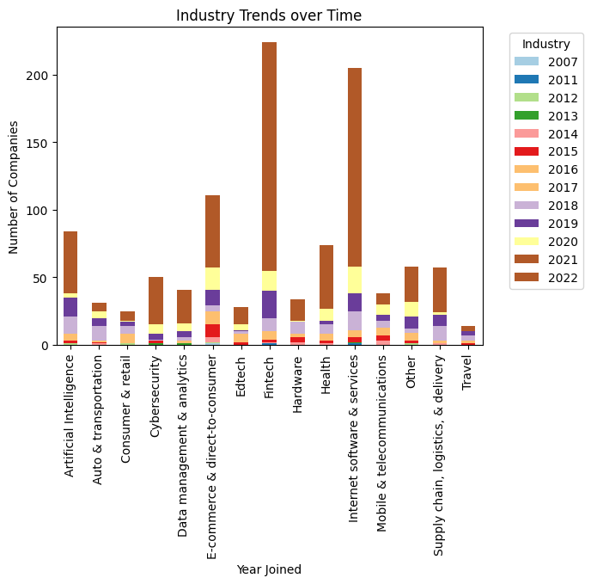
Fintech is continuously evolving between 2021 to 2022, followed by AI, e-commerce, and software.
AI starts to boost between 2018-2019.

Slide 12
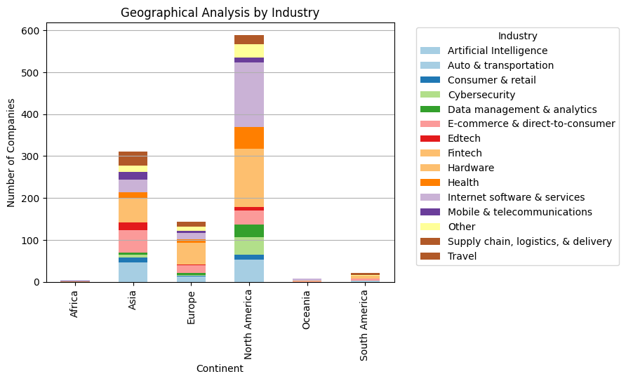
In North America, we can see the fintech industry & internet software and services are evolving rapidly.
In Asia and Europe fintech is booming along with supply chain, logistics & delivery.
In Asia and North America, AI is continuously booming.

Slide 13
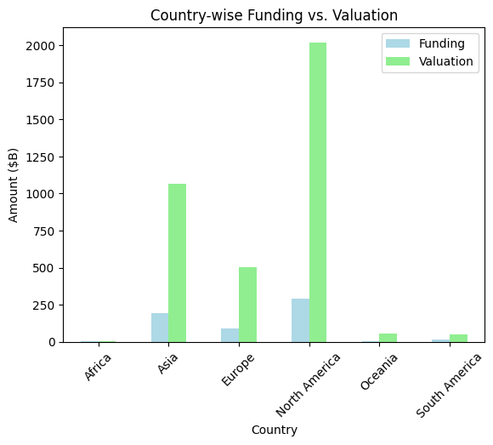
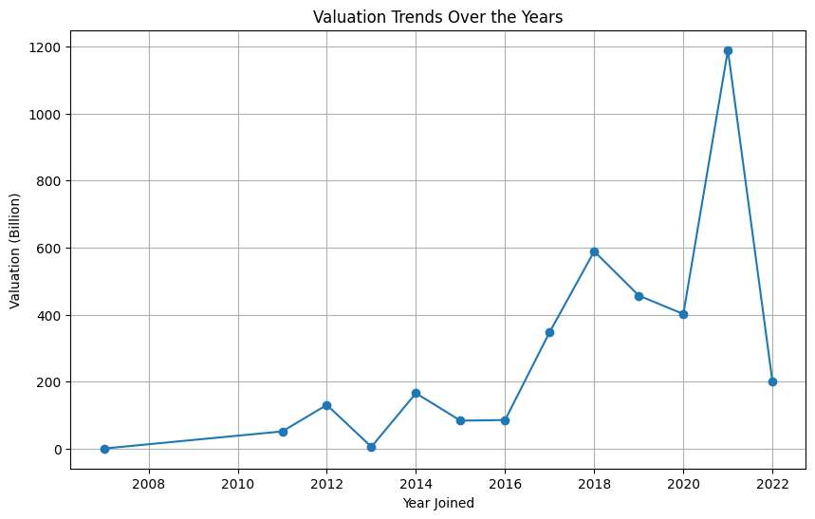
As we can see from the left graph, Companies belonging to North America raised very little funding as compared to their valuation.
From the right zig-zag graph, the valuation of the company experience a sharp peak in 2018 as well as in 2021.

Slide 14
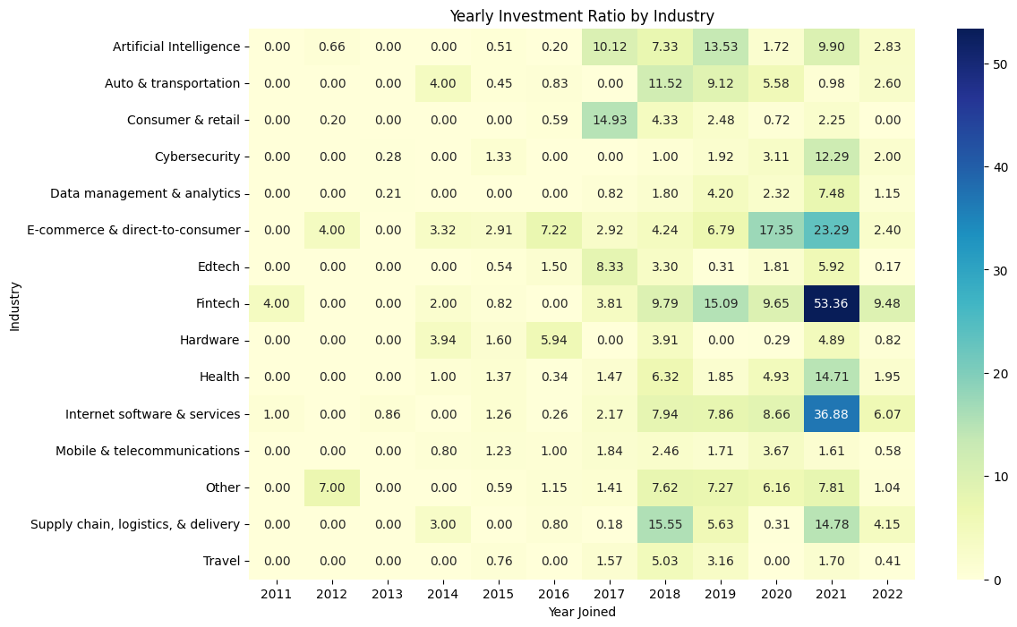
We can see from the above heat map that the fintech, E-commerce, and software services are continuously evolving around 2021.

Slide 15


